Slide 1

JavaScript

Slide 2
Brendan Eich
Creator of the JavaScript

Slide 3
Index
What is JavaScript ?

Slide 4
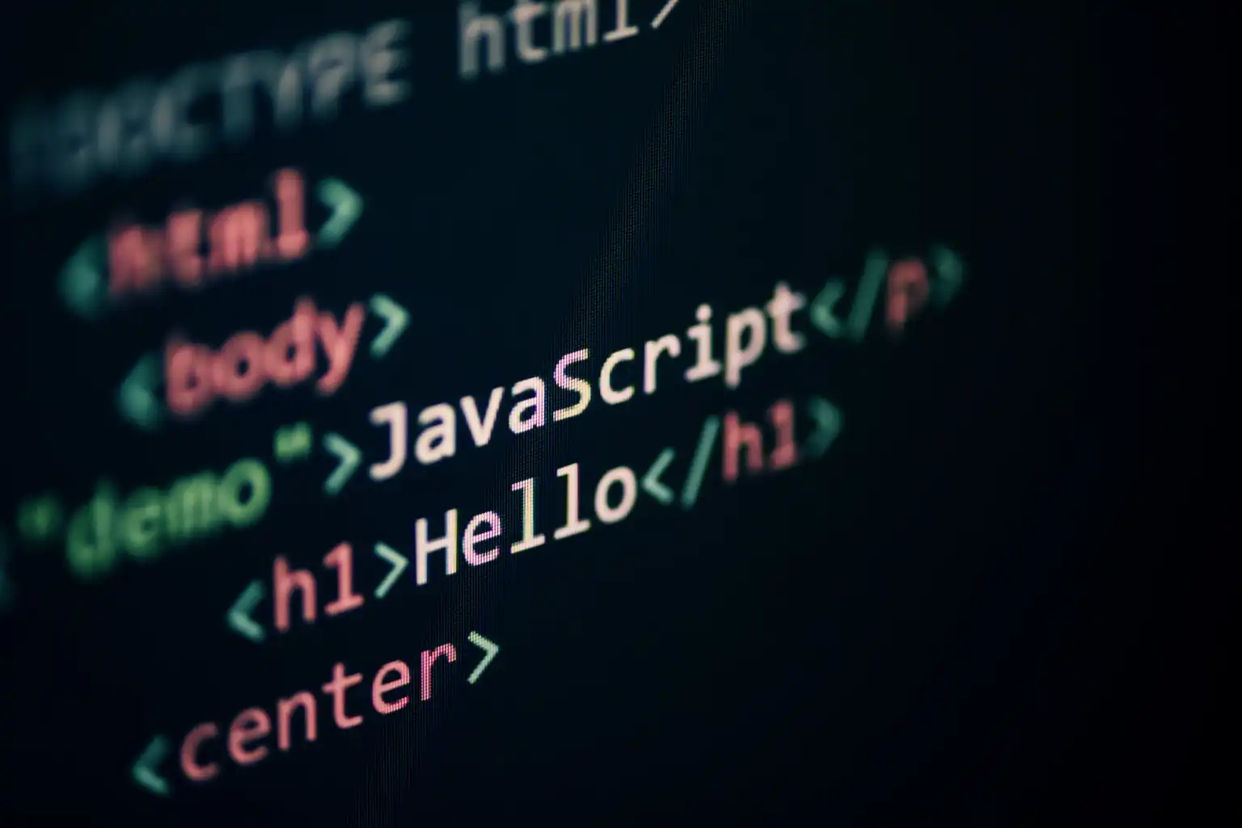

What is JavaScript ?
JavaScript is a high-level, dynamic, interpreted programming language that is widely used for web development.
It enables developers to add interactive and dynamic behaviour to websites.
JavaScript is versatile, capable of running on the client side (in browsers) and the server side (with platforms like Node.js).

Slide 5
Use Cases:
  Frontend development (web apps, UI interactions)
  Backend development (Node.js)
  Mobile app development (React Native, etc.)
  Game development and more.

Slide 6
Some facts about JavaScript:
Creator: Brendan Eich
Created at: Netscape Communications Corporation
Year of creation: 1995
Purpose: JavaScript was created to add interactivity and dynamic functionality to web pages. It was developed to complement Java (not replace it) and to provide simple scripting capabilities for web browsers.
Development Time: JavaScript was created in just 10 days!
Initially, it was named Mocha, later changed to LiveScript, and finally renamed JavaScript to capitalize on Java's popularity at the time.

